Slide 1
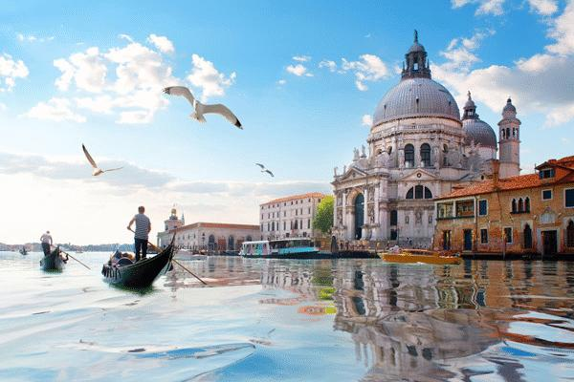
Venice-The Sinking City
By Ryca Zhang
https://www.jiemian.com/article/4990611.html

Slide 2

Game Setting
Venice, Italy 2040
Player: A traveller
Background Story: In the year of 2040, most residents moved out of Venice because the city is sinking due to global warming. At this moment, the narrator comes here to have the last chance to see this city. However, something not normal will happen during his stay in Venice. The player must survive and escape the city.

Slide 3
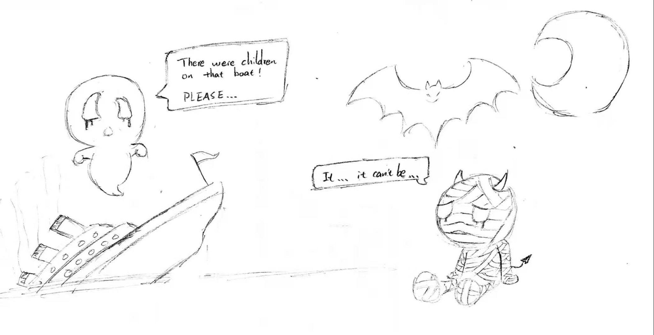
Game Mechanics
Day:
Explore the city
Meet NPCs to get information
Gain food and exchange useful tools
Night:
Ghosts will appear
Kill bad ghosts and save good ghosts
Find paths to escape

Slide 4
Players’ Experience Goal
At first, players will feel peace and love.
Exploring the city in a first-person VR view is very beautiful.
Use hand controller to control the movement
Have the experience of collecting things, boating and fishing in the game.
When the night comes, players will feel scared.
Ghosts appear and some of them will attack players
Fight them with your sword
Save ghosts will help strengthen your abilities
Overall, warn players to have the consciousness of stopping the world from global warming.

Slide 5
Story Board
Scene 1：
You landed at Venice. You know this city have no population. It was flooded because of global warming.You walk ahead and pick up a book on the ground. This is a traveller guide. You read it. The book wakes up your memory. In your memory, about 20 years ago, this city is one of the most famous places for travellers around the world. Millions of people come here every year. You feel sad. However, this is a chance for you to explore the city that you have never been to.

Slide 6
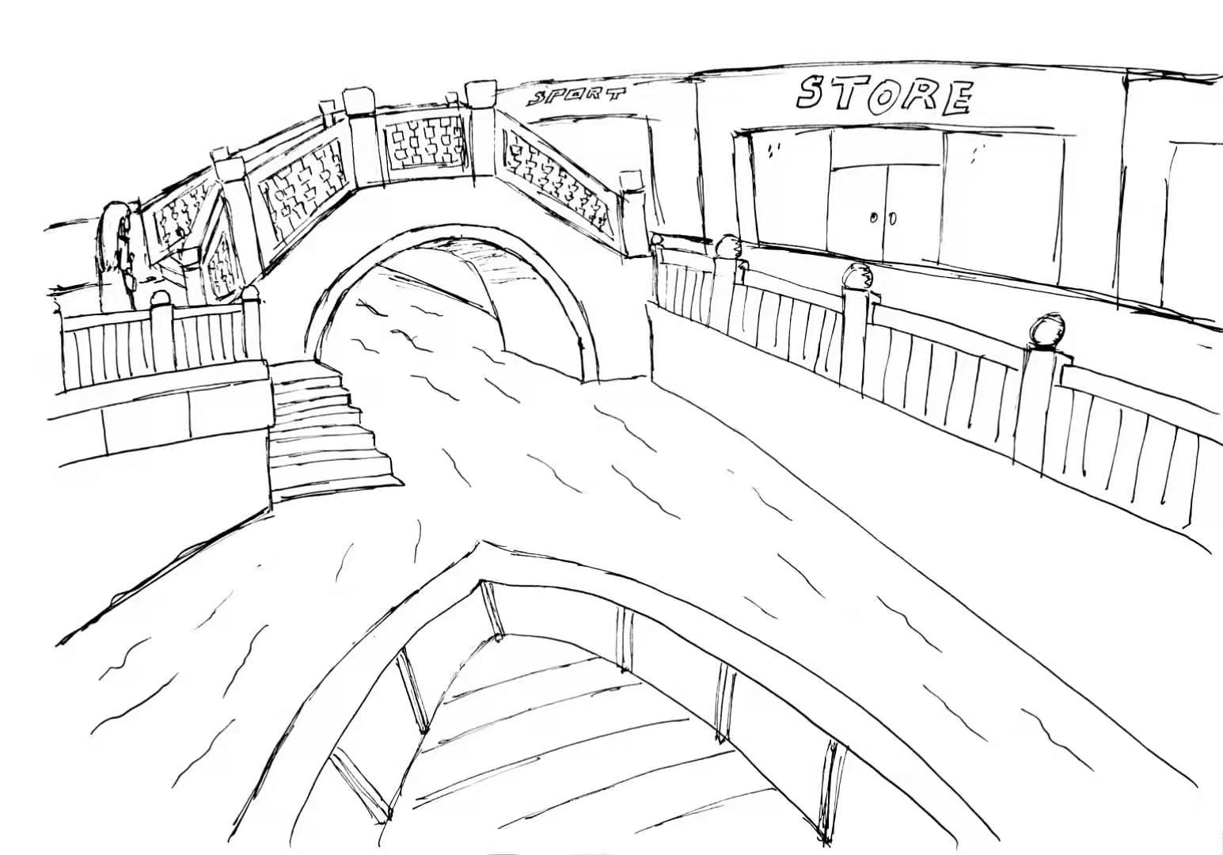
Scene 2:
You continue walk ahead, you find there is a boat parking near you. You find this place is the old canal. You start boating along the canal into the city. Houses along the canal are all empty except for a store. You are surprised. You go to the store to see if there are people.

Slide 7
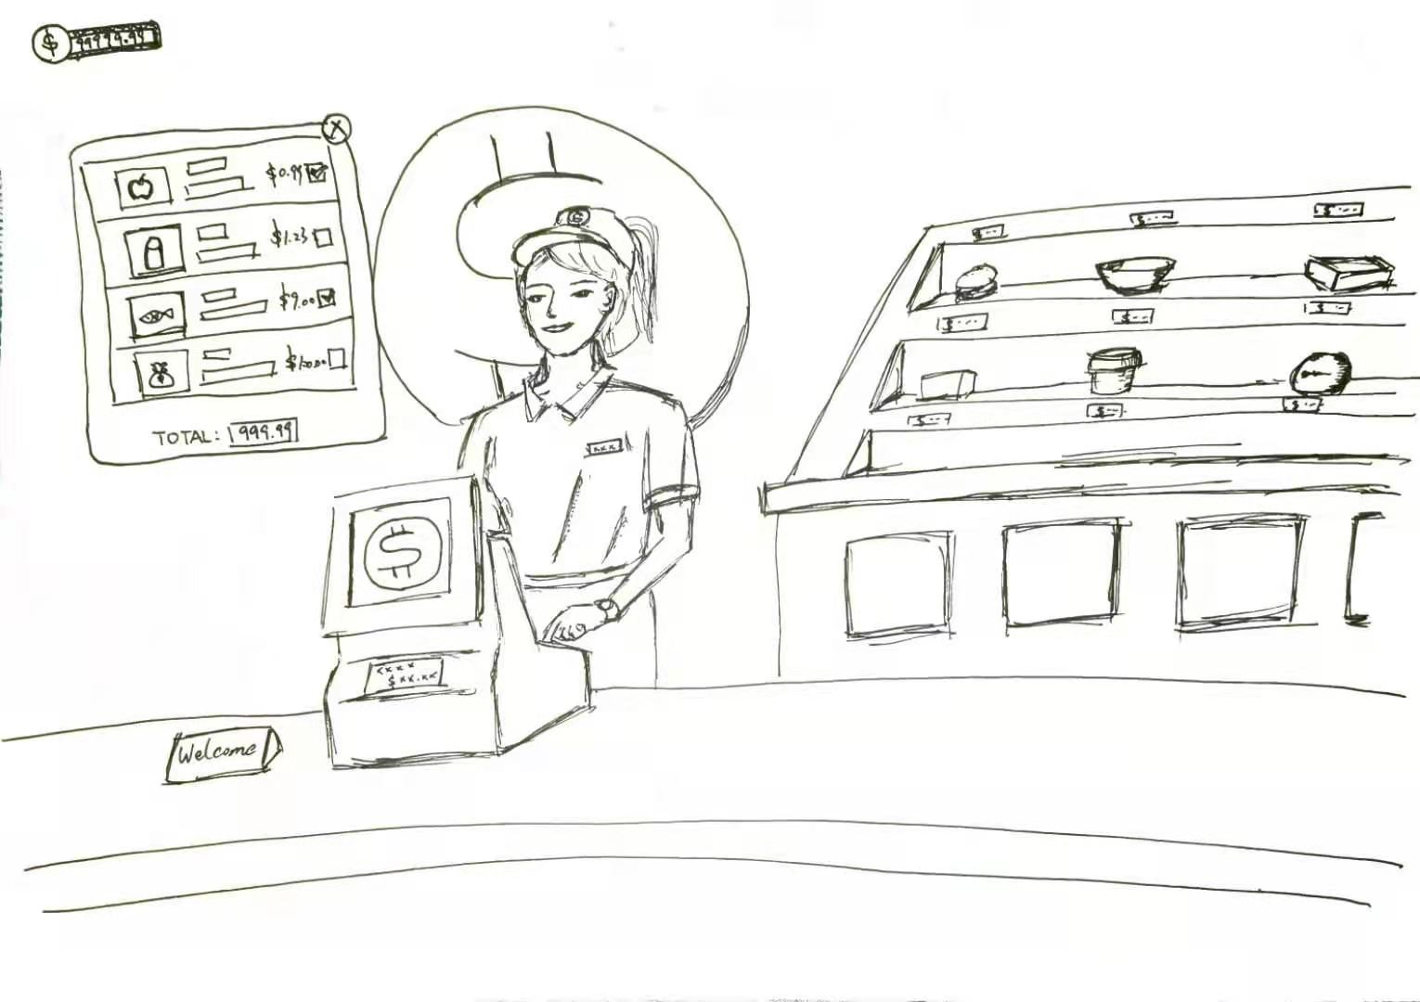
Scene 3:
You walk in the store. You see a person. This person is surprised too. “Wow, It has been a long time since I saw a traveller here. I have some merchandise left at my store. What do you want?” According to the conversation, you learn that you can exchange things with him. He also tells you that you can go fishing. In the end of the conversation, he asks you to be careful at night.

Slide 8
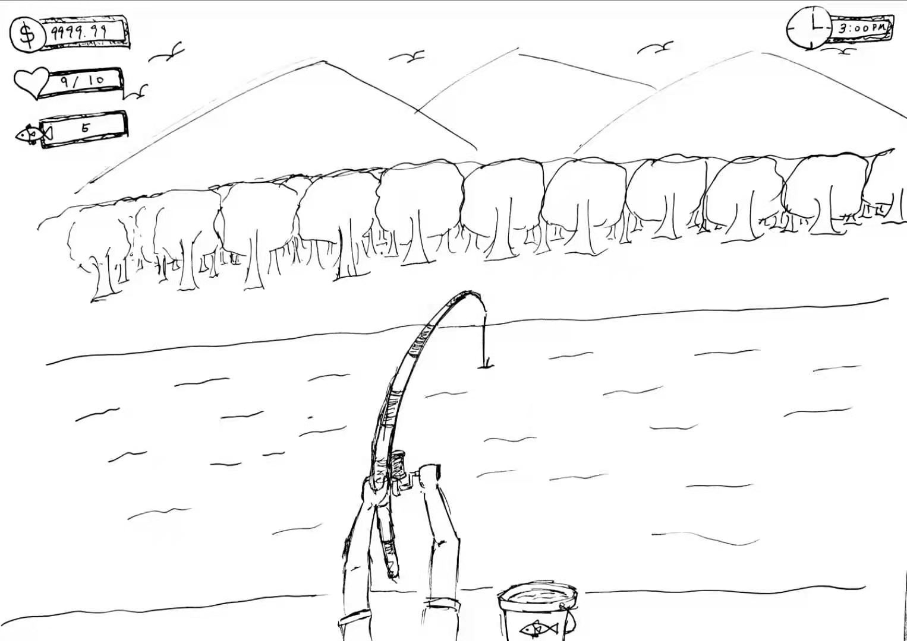
Scene 4:
You think this person, this store and this city are weird. However, you decide to try to catch some fish to eat. You enjoy going fishing here. After fishing, you paddle the boat along the canal, to a huge bridge.

Slide 9
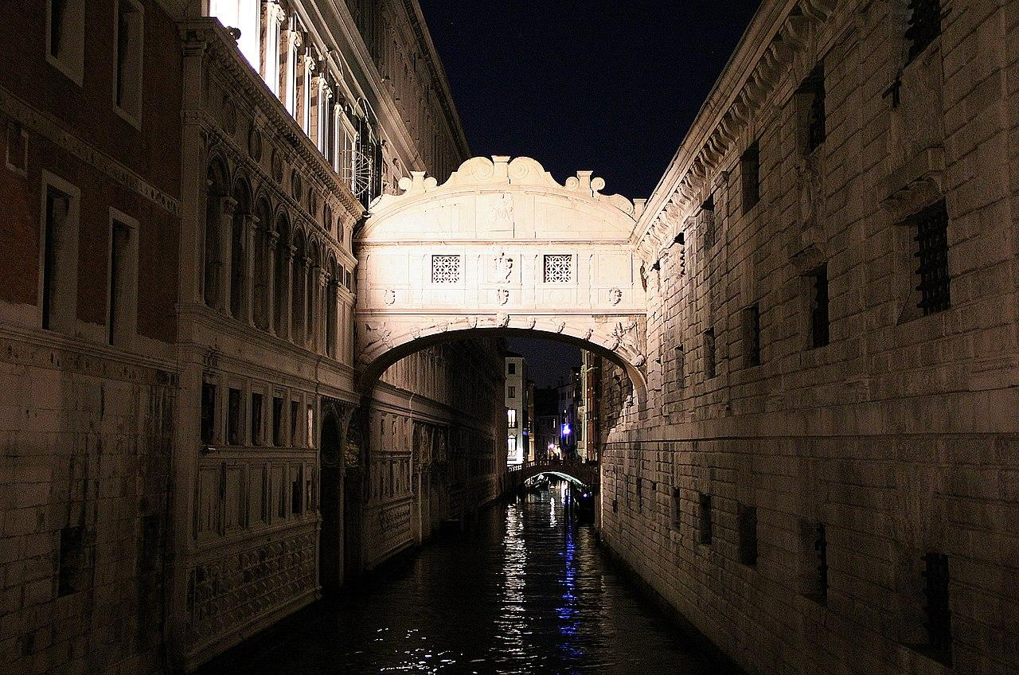
Scene 5: The sky turns dark. You see a huge bridge. Some voice spread from the bridge. You hear some sighs. You are not sure if you are mishearing. You decide to approach it to see what happened.
https://www.wikiwand.com/en/Bridge_of_Sighs

Slide 10
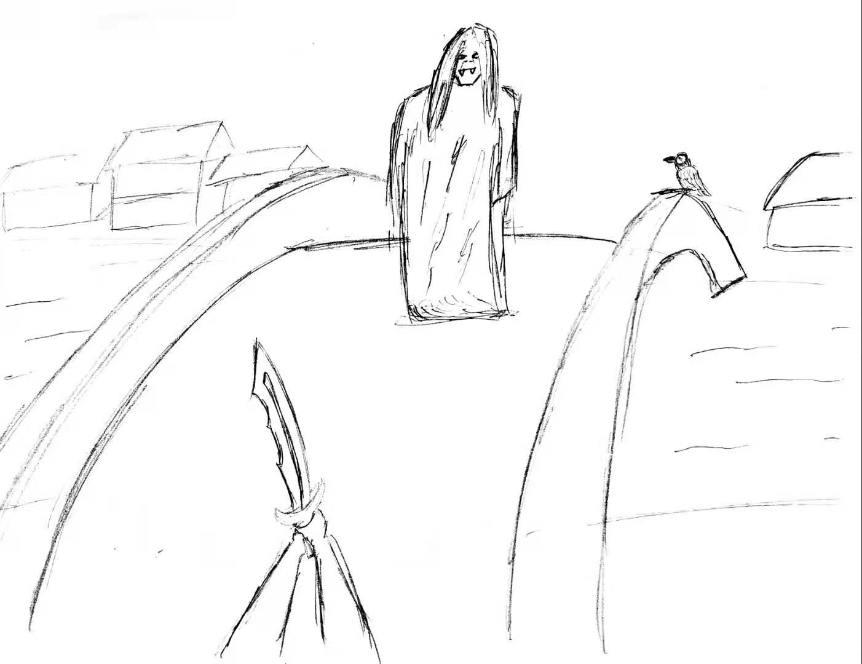
Scene 6: Battle scene
A ghost appears and it starts to attack you! You take out your sword from your bag. Although you are afraid, you must fight with it!

Slide 11
Scene 7:
You beat the ghost. The ghost disappears and turns into a light bumps into your sword. You feel you are more powerful. You walk down the bridge. This time, you see more ghosts appear. You are shocked but you find they don’t attack you. You walk closed to them. They make lots of noise saying some words.

Slide 12
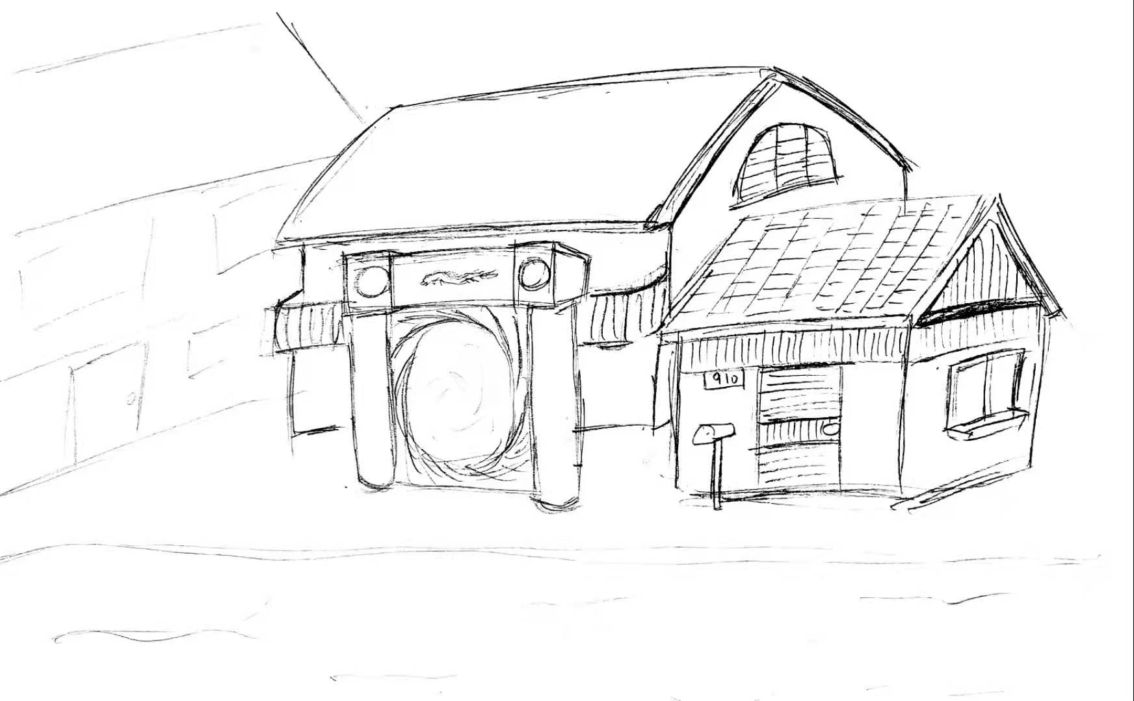
Scene 8:
You learned that they are the souls of people who died from the flood. They asked you to save them or they will be trapped in this sinking city forever. You take these souls and continue to find paths to leave the city. Every day and night you have various adventures in this city. (Game Continues)
Finally, one day you use your ability to open a portal to leave here. Hope the tragedy of Venice won’t happen anymore.

